Slide 1
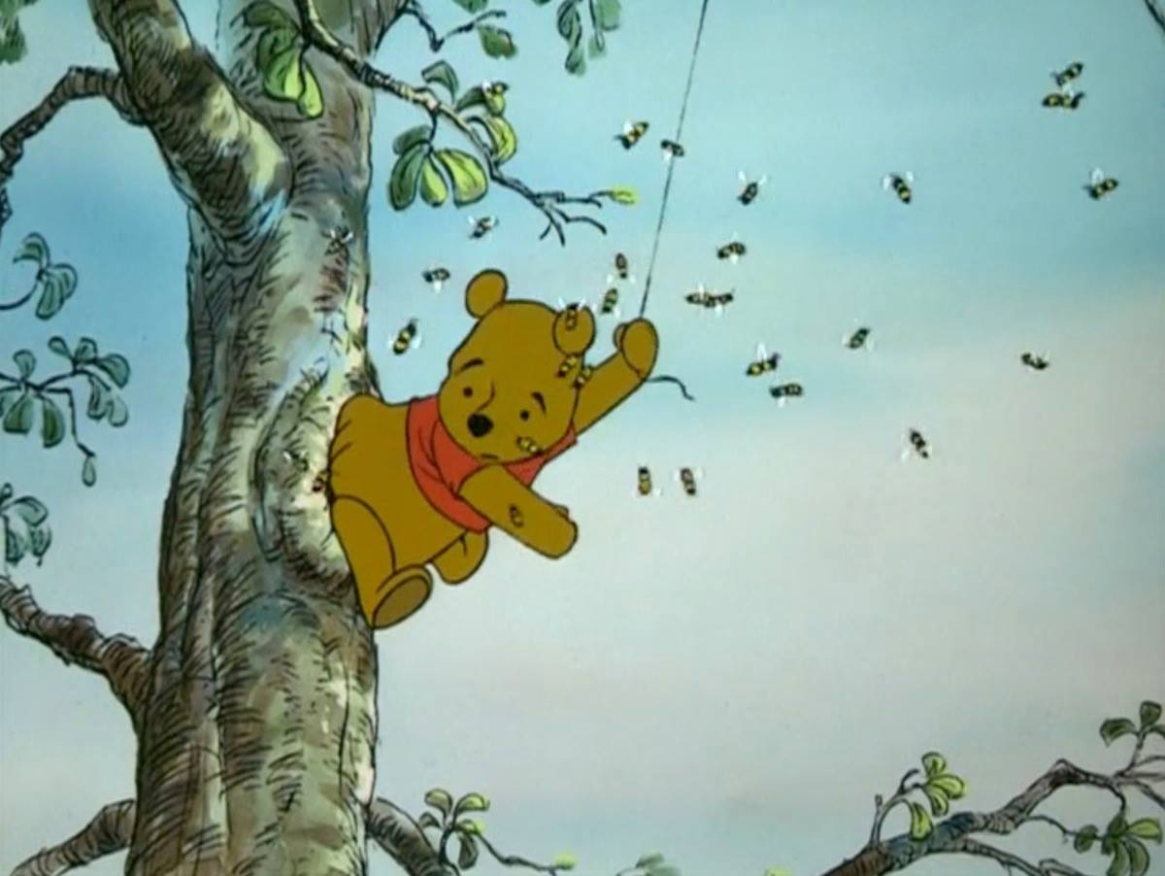
B-Trees
“Doing more things faster is no substitute for doing the right things."
-Stephen R. Covey
CLRS, Sections 18.1 – 18.3

Slide 2
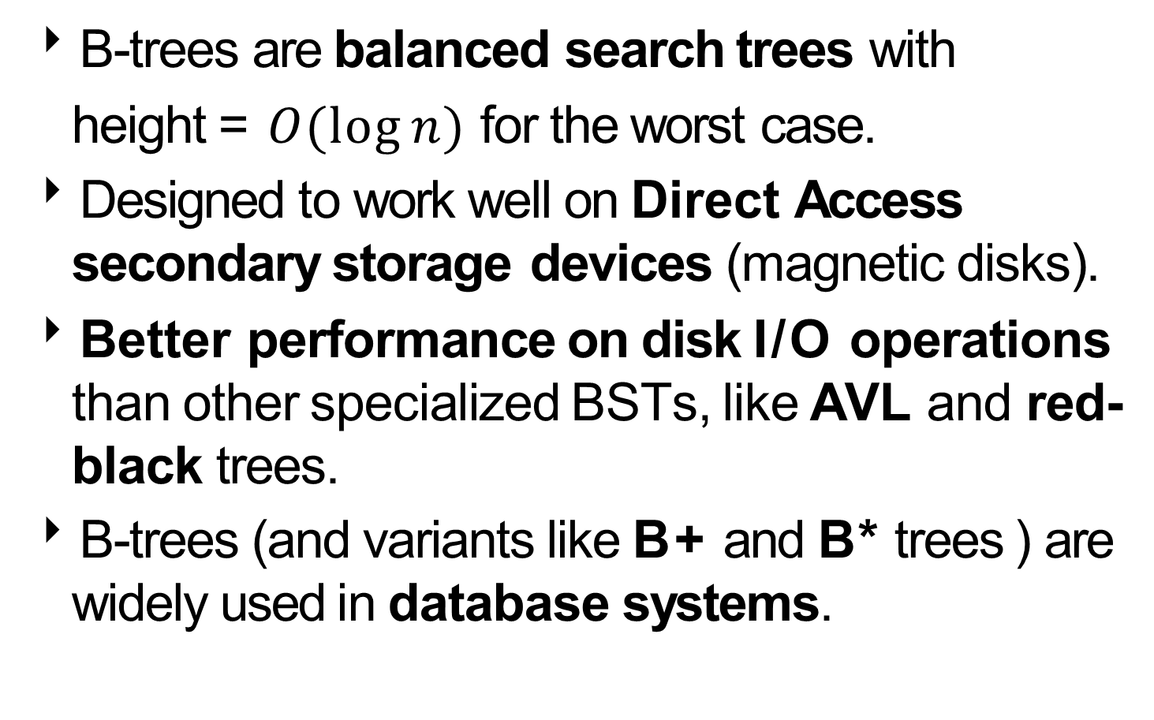
What are B-trees?
B-trees are balanced search trees with
height = $O(\log{n)}$for the worst case.
Designed to work well on Direct Access secondary storage devices (magnetic disks).
Better performance on disk I/O operations than other specialized BSTs, like AVL and red-black trees.
B-trees (and variants like B+ and B* trees ) are widely used in database systems.
Notes:
A B+ tree is an N-ary tree with a variable but often large number of children per node. A B+ tree consists of a root, internal nodes and leaves. The root may be either a leaf or a node with two or more children.
A B+ tree can be viewed as a B-tree in which each node contains only keys (not key–value pairs), and to which an additional level is added at the bottom with linked leaves.
The B* tree balances more neighboring internal nodes to keep the internal nodes more densely packed. This variant ensures non-root nodes are at least 2/3 full instead of 1/2. As the most costly part of operation of inserting the node in B-tree is splitting the node, B*-trees are created to postpone splitting operation as long as they can. To maintain this, instead of immediately splitting up a node when it gets full, its keys are shared with a node next to it.

Slide 3
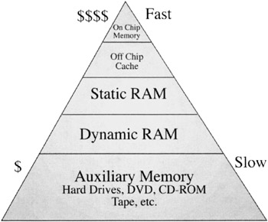
Motivation
Memory capacity in computer systems consists broadly of 2 parts:
Main memory (RAM): uses memory chips.
Secondary storage: based on magnetic disks.
Magnetic disks are cheaper and have higher capacity.
But they are much slower because they have moving parts.

Slide 4
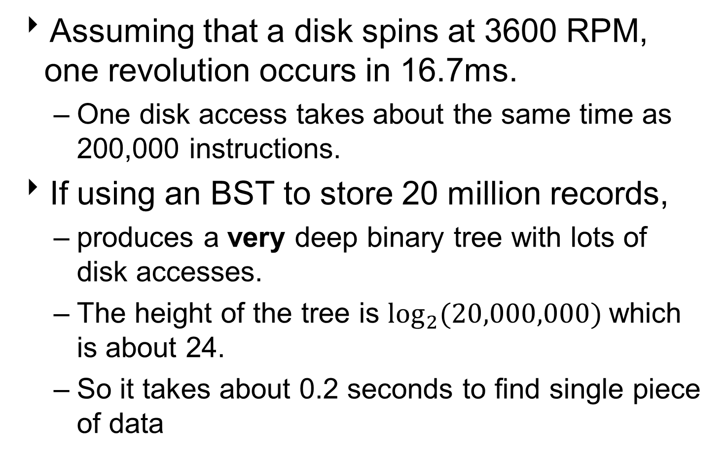
Motivation
Assuming that a disk spins at 3600 RPM, one revolution occurs in 16.7ms.
One disk access takes about the same time as 200,000 instructions.
If using an BST to store 20 million records,
produces a very deep binary tree with lots of disk accesses.
The height of the tree is $\log_{2}{(20,000,000)}$which is about 24.
So it takes about 0.2 seconds to find single piece of data

Slide 5
Motivation
Data structures on secondary storage:
To facilitate faster access to datasets with a very large number of records, store extra information about the datasets.
Principle device for organizing such sets is called an index.
Provides information about the location of records with indicated key values.

Slide 6
Motivation
Because even the index structures for large datasets are too big to store in main memory, storing it on disk requires different approach to efficiency.
For datasets of structured records, use B-Trees.
B-trees try to read as much information as possible in every disk access operation.

Slide 7
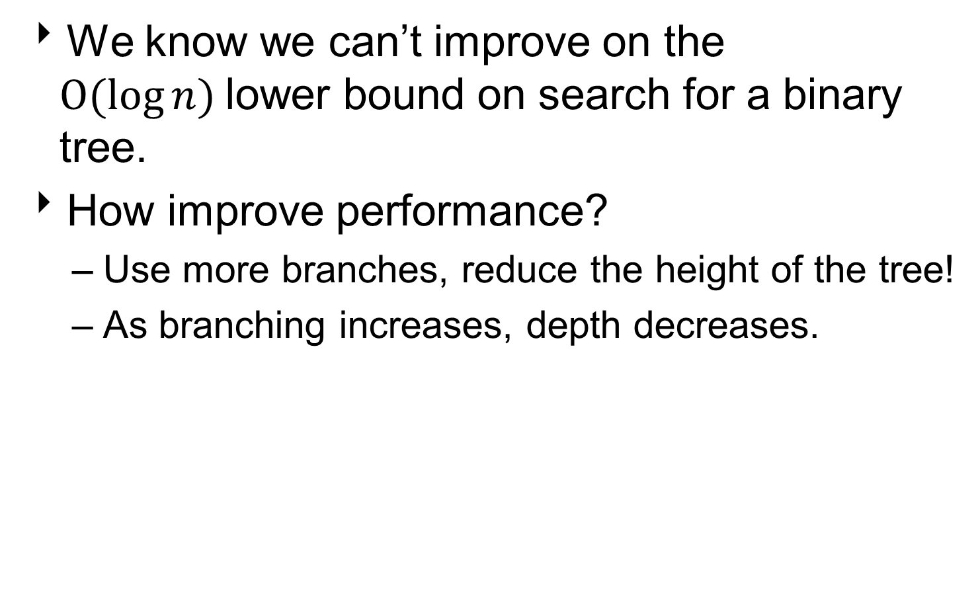
B-Tree Approach
We know we can’t improve on the $O(log{n)}$lower bound on search for a binary tree.
How improve performance?
Use more branches, reduce the height of the tree!
As branching increases, depth decreases.

Slide 8
What is a B-Tree?
B-Trees are generalization of BSTs.
A B-Tree of order m is an m-way tree.
A tree where each node may have up to m children.
7
16
2
5
6
9
12
18
21

Slide 9
Definition of a B-Tree
Each node of a B-tree contains a number of key / data pairs = number of children – 1.
The keys divide the node’s children into ranges.
If an internal node has 3 children or subtrees, it must have 2 keys: a₁ and a₂.
All keys in the leftmost subtree will be less than a₁,
All keys in the middle subtree will be between a₁ and a₂
All keys in the rightmost subtree will be greater than a₂.

Slide 10
Example B-Tree
This node has 2 <key, data> pairs:
The keys are 7, 16.
Its leftmost subtree has keys ≤ 7.
Its middle subtree has keys > 7 and ≤ 16.
Its rightmost subtree has keys > 16.
7
16
2
5
6
9
12
18
21

Slide 11
Properties of B-Tree
The minimum degree of the tree t = ⎡m/2⎤ ≥ 2.
For some of the algorithms, m = 2t, so assume m is even.
The root has between 0 and m-1 keys.
If the tree is empty, then the root has no children.
Otherwise, number of children is between 2 and m
Internal nodes have between t-1 and m-1 keys.
Number of children is between t and m.
Leaves also have between t-1 and m-1 keys.
All leaves have the same depth, which is the height h of the tree

Slide 12
Maximum Number of Items
Maximum number of items in a B-tree of order m and height h:
root m – 1
level 1 m(m – 1)
level 2 m²(m – 1)
. . .
level h m^{h}(m – 1)
Therefore, the total number of items is:
(1 + m + m² + m³ + … + m^{h})(m – 1) = [(m^{h+1} – 1)/ (m – 1)] (m – 1) = m^{h+1} – 1
When m = 4 and h = 2, this gives 4³ – 1 = 63

Slide 13








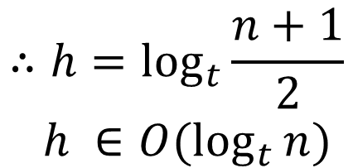
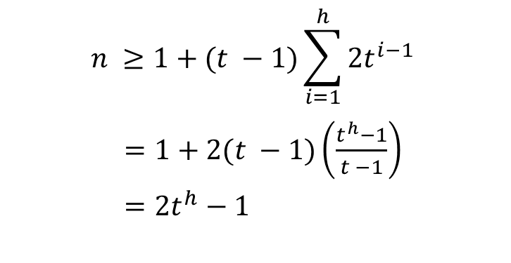
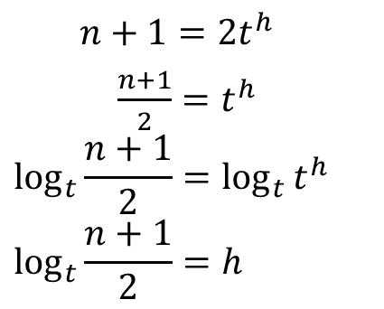
Height of B-Tree
depth
number of nodes
1
0
1
t − 1
t − 1
1
2
t
· · ·
t
· · ·
t − 1
t − 1
t − 1
t − 1
2
2t
t
t
t
t
t − 1 · · · t − 1 t − 1 · · · t − 1 t − 1 · · · t − 1 t − 1 · · · t − 1
3
2t²
$$n ≥1+(t −1)\sum_{i=1}^{h}{2t^{i−1}}$$
$=1+2(t −1)\left(\frac{t^{h}−1}{t −1}\right)$
$=2t^{h}−1$
$$n+1=2t^{h}$$
$\frac{n+1}{2}=t^{h}$
$$\log_{t}{\frac{n+1}{2}=\log_{t}{t^{h}}}$$
$$\log_{t}{\frac{n+1}{2}=h}$$
$$∴h=\log_{t}{\frac{n+1}{2}}$$
$$h ∈O(\log_{t}{n)}$$

Slide 14
Optimal Tree Order
Suppose that the disk block size is 4096 bytes.
Each node has a 200 bytes of meta-data to store.
The size of each key is 120 bytes.
Each pointer has size 8 bytes.
Find the optimal order m for this disk block size.
4096 ≥ 200 + 8 + 120*(m-1) + 8*(m)
30 ≥ m
number of keys
pointers to children
pointer to the parent

Slide 15
B-Tree Node
A node x in a B-Tree has the following attributes:
x.n: number of keys stored in the node x.
References to x.n <keys, data> pairs
stored in non-decreasing order:
x.key₁ ≤ x.key₂ ≤ … ≤ x.key_{x.n}
A boolean value x.leaf, true if the node is a leaf.
x.n+1 pointers to its children, ordered by their keys:
x.c₁, x.c₂, … , x.c_{x.n+1}
which are also B-Tree nodes.

Slide 16
B-Tree Node Example
This node has:
x.n = 2 <key, data> pairs
with the keys 7, 16
x.leaf = false
x.n+1 = 3 children
7
16
2
5
6
9
12
18
21

Slide 17
An Example
The consonants of the English alphabet as keys of an order-4 B-tree:
M
D | H
Q | T | X
B | C
F | G
J | K | L
N | P
R | S
V | W
Y | Z
Every internal node x containing x.n keys has x.n+1 children.
All leaves are at the same depth in the tree.

Slide 18
Basic B-Trees Operations
Search
Create
Insert
Delete
Conventions:
Root of B-Tree is always in main memory (Disk-Read on the root is never required).
Any node passed as parameter must have had a Disk-Read operation performed on them.
Procedures presented are all top down algorithms (no need to backtrack) starting at the root of the tree.

Slide 19
B-Tree Search
Search for object with key R:
addresses of B-Tree nodes
r
M
a
D | H
b
Q | T | X
B | C
F | G
J | K | L
N | P
R | S
V | W
Y | Z
c
d
e
f
g
h
i

Slide 20
B-Tree Search
Start at root r.
Because r.key₁ = M < R and r.n = 1
search in r.c₂ = b
index of key
1
r
M
a
D | H
b
Q | T | X
B | C
F | G
J | K | L
N | P
R | S
V | W
Y | Z
c
d
e
f
g
h
i

Slide 21
B-Tree Search
Because b.key₁ = Q < R and b.key₂ = T > R
search in b.c₂ = g
r
M
1
2
a
D | H
b
Q | T | X
B | C
F | G
J | K | L
N | P
R | S
V | W
Y | Z
c
d
e
f
g
h
i

Slide 22
B-Tree Search
Because g.key₁ = R = target key
return g and 1, the index of the key
r
M
a
D | H
b
Q | T | X
1
B | C
F | G
J | K | L
N | P
R | S
V | W
Y | Z
c
d
e
f
g
h
i

Slide 23
B-Tree Search Algorithm
function B-Tree-Search(x,k)
// inputs: x, pointer to the root node of a subtree
// k, target key in that subtree
// returns (y, i) such that y.key_{i} = k or nil
i ← 1
while i ≤ x.n and k > x.key_{i}
do i ← i + 1
if i ≤ x.n and k = x.key_{i}
then return (x, i)
if x.leaf
then return nil
else Disk-Read(x.c_{i})
return B-Tree-Search(x.c_{i}, k)
At each internal node x, make an (x.n+1)-way branching decision.

Slide 24
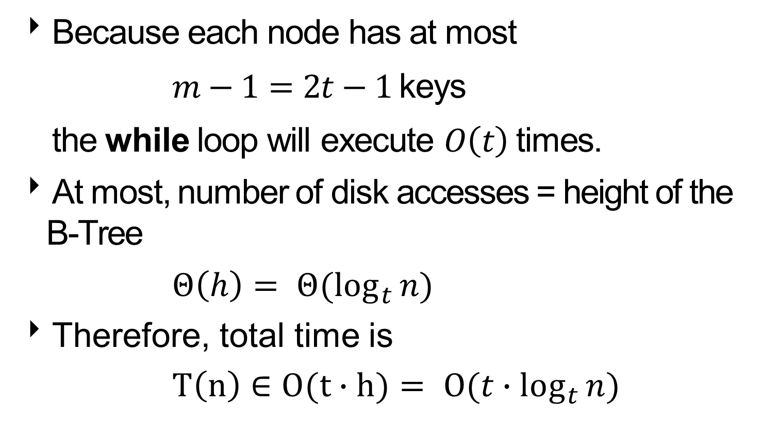
Analysis of Search Algorithm
Because each node has at most
$m−1=2t−1$keys
the while loop will execute $O\left(t\right)$times.
At most, number of disk accesses = height of the B-Tree
$Θ\left(h\right)= Θ(\log_{t}{n)}$
Therefore, total time is
$T\left(n\right)∈O(t∙h)= O(t∙\log_{t}{n)}$

Slide 25
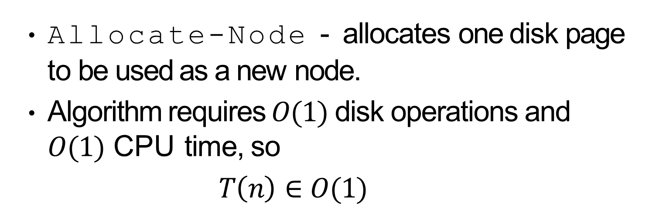
Creating Empty B-Tree
function B-Tree-Create(T)
x ← Allocate-Node()
x.leaf ← true
x.n ← 0
Disk-Write(x)
T.root ← x
Allocate-Node - allocates one disk page to be used as a new node.
Algorithm requires $O(1)$ disk operations and $O(1)$ CPU time, so
$T\left(n\right)∈O(1)$

Slide 26
Inserting into a B-Tree
Find leaf where key should be inserted:
If the leaf has less than m–1 keys
Insert the new <key, data> pair into the leaf.
If the leaf has m–1 keys
Insert the new <key, data> pair into the leaf.
Split the leaf in two.
Promote the middle key to the leaf’s parent.
If the parent now has m-1 keys
Repeat split / promotions until reach node with less than m-1 keys.
If reach root, create new root, split old root and promote its middle key.

Slide 27
Case 1: Space in Leaf
Insert A:
r
M
a
D | H
b
Q | T | X
B | C
F | G
J | K | L
N | P
R | S
V | W
Y | Z
c
d
e
f
g
h
i

Slide 28
Case 1: Space in Leaf
Start at root r.
Because r.leaf = false, r.key₁ = M > A
try to insert in r.c₁ = a
1
r
M
a
D | H
b
Q | T | X
B | C
F | G
J | K | L
N | P
R | S
V | W
Y | Z
c
d
e
f
g
h
i

Slide 29
Case 1: Space in Leaf
Because a.leaf = false, a.key₁ = D > A
try to insert in a.c₁ = c
r
M
1
a
D | H
b
Q | T | X
B | C
F | G
J | K | L
N | P
R | S
V | W
Y | Z
c
d
e
f
g
h
i

Slide 30
Case 1: Space in Leaf
Because c.leaf = true
insert A into c
r
M
a
D | H
b
Q | T | X
A
1
B | C
F | G
J | K | L
N | P
R | S
V | W
Y | Z
c
d
e
f
g
h
i

Slide 31
Case 1: Space in Leaf
Since c.n = 3 = m–1, done.
r
M
a
D | H
b
Q | T | X
A | B | C
F | G
J | K | L
N | P
R | S
V | W
Y | Z
c
d
e
f
g
h
i

Slide 32
Case 2: No Space in Leaf
Insert I:
r
M
a
D | H
b
Q | T | X
A | B | C
F | G
J | K | L
N | P
R | S
V | W
Y | Z
c
d
e
f
g
h
i

Slide 33
Case 2: No Space in Leaf
Start at root r.
Because r.leaf = false, r.key₁ = M > I
try to insert in r.c₁ = a
1
r
M
a
D | H
b
Q | T | X
A | B | C
F | G
J | K | L
N | P
R | S
V | W
Y | Z
c
d
e
f
g
h
i

Slide 34
Case 2: No Space in Leaf
Because a.leaf = false, a.key₁ = D < I, a.key₂ = H < I
try to insert in a.c₃ = e
r
M
1
2
a
D | H
b
Q | T | X
A | B | C
F | G
J | K | L
N | P
R | S
V | W
Y | Z
c
d
e
f
g
h
i

Slide 35
Case 2: No Space in Leaf
Because e.leaf = true
insert I into e
r
M
a
D | H
b
Q | T | X
A | B | C
F | G
J | K | L
N | P
R | S
V | W
Y | Z
c
d
e
f
g
h
i
I

Slide 36
Case 2: No Space in Leaf
But now e.n = 4 > m-1 = 3
Have to split node.
Promote middle key J to parent.
r
M
a
D | H
b
Q | T | X
J
A | B | C
F | G
I | J | K | L
N | P
R | S
V | W
Y | Z
c
d
e
f
g
h
i

Slide 37
Case 2: No Space in Leaf
Since a.n = 3 = m-1, done.
Note: t–1 = ⎡m/2⎤ -1 = 1, so minimum number of keys is 1
r
M
a
D | H | J
b
Q | T | X
A | B | C
F | G
I
K | L
N | P
R | S
V | W
Y | Z
c
d
e
j
f
g
h
i

Slide 38
Case 3: No Space in Parent
Insert another C.
r
M
a
D | H | J
b
Q | T | X
A | B | C
F | G
I
K | L
N | P
R | S
V | W
Y | Z
c
d
e
j
f
g
h
i

Slide 39
Case 3: No Space in Parent
Start at root r.
Because r.leaf = false, r.key₁ = M > C
try to insert in r.c₁ = a
1
r
M
a
D | H | J
b
Q | T | X
A | B | C
F | G
I
K | L
N | P
R | S
V | W
Y | Z
c
d
e
j
f
g
h
i

Slide 40
Case 3: No Space in Parent
Because a.leaf = false, a.key₁ = D > C
try to insert in a.c₁ = c
r
M
1
a
D | H | J
b
Q | T | X
A | B | C
F | G
I
K | L
N | P
R | S
V | W
Y | Z
c
d
e
j
f
g
h
i

Slide 41
Case 3: No Space in Parent
Because a.leaf = true
insert C into c
r
M
a
D | H | J
b
Q | T | X
A | B | C
F | G
I
K | L
N | P
R | S
V | W
Y | Z
c
d
e
j
f
g
h
i
C

Slide 42
Case 3: No Space in Parent
But now c.n = 4 > m-1 = 3
Have to split node.
Promote middle key B to parent.
r
M
a
D | H | J
b
Q | T | X
B
A | B | C | C
F | G
I
K | L
N | P
R | S
V | W
Y | Z
c
d
e
j
f
g
h
i

Slide 43
Case 3: No Space in Parent
Now a.n = 4 > m-1 = 3
Have to split node.
Promote middle key D to root.
r
M
D
a
B | D | H | J
b
Q | T | X
A
C | C
F | G
I
K | L
N | P
R | S
V | W
Y | Z
c
k
d
e
j
f
g
h
i

Slide 44
Case 3: No Space in Parent
Since r.n = 2 < m-1 = 3, done.
r
D | M
a
B
l
H | J
b
Q | T | X
A
C | C
F | G
I
K | L
N | P
R | S
V | W
Y | Z
c
k
d
e
j
f
g
h
i

Slide 45
Insertion Algorithm
function B-Tree-Insert(T,o)
// inputs: T, pointer to a subtree
// o, pointer to object inserting into subtree
r ← T.root
if r.n = m − 1
then s ← Allocate-Node()
T.root ← s
s.leaf ← false
s.n ← 0
s.c₁ ← r
B-Tree-Split-Child(s,1,r)
B-Tree-Insert-Nonfull(s,o.key)
else B-Tree-Insert-Nonfull(r,o.key)
Uses B-Tree-Split-Child to split node in two and promote
object with middle key and B-Tree-Insert-Nonfull to insert
object o into non-full node x.

Slide 46
Splitting Node Algorithm I
function B-Tree-Split-Child(x, i, y )
//inputs:
// x, a nonfull internal node
// i, an index
// y, a node y = x.c_{i}, a full
// child of x.
z ← Allocate-Node()
z.leaf ← y.leaf
z.n ← t −1
for j ← 1 to t − 1
do z.key_{j} ← y.key_{j+t}
if not y.leaf
then for j ← 1 to t
do z.c_{j} ← y.c_{j+t}
y.n ← t − 1

Slide 47
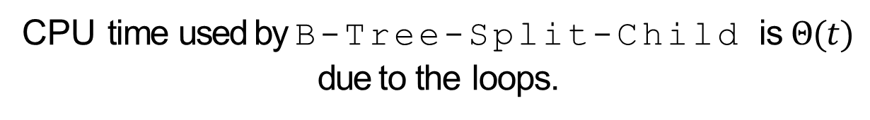
Splitting Node Algorithm II
for j ← x.n + 1 downto i + 1
do x.c_{j+1} ← x.c_{j}
x.c_{i+1} ← z
for j ← x.n downto i
do x.key_{j+1} ← x.key_{j}
x.key_{i} ← y.key_{t}
x.n ← x.n + 1
Disk-Write(y)
Disk-Write(z)
Disk-Write(x)
CPU time used by B-Tree-Split-Child is $Θ(t)$ due to the loops.

Slide 48
Non-full Node Insertion Algorithm I
function B-Tree-Insert-Nonfull(x, o)
//inputs:
// x, a nonfull internal node
// o, pointer to object
// inserting into node
i ← x.n
if x.leaf
then while i ≥ 1 and o.key < x.key_{i}
do x.key_{i+1} ← x.key_{i}
i ← i − 1
key_{i+1}[x] ← o.key
x.n ← x.n + 1
Disk-Write(x)

Slide 49
Non-full Node Insertion Algorithm II
else while i ≥ 1 and o.key < x.key_{i}
do i ← i − 1
i ← i + 1
Disk-Read(x.c_{i})
if (x.c_{i}).n = m − 1
then B-Tree-Split-Child(x, i, x.c_{i})
if o.key > x.key_{i}
then i ← i + 1
B-Tree-Insert-Nonfull(x.c_{i},o.key)

Slide 50
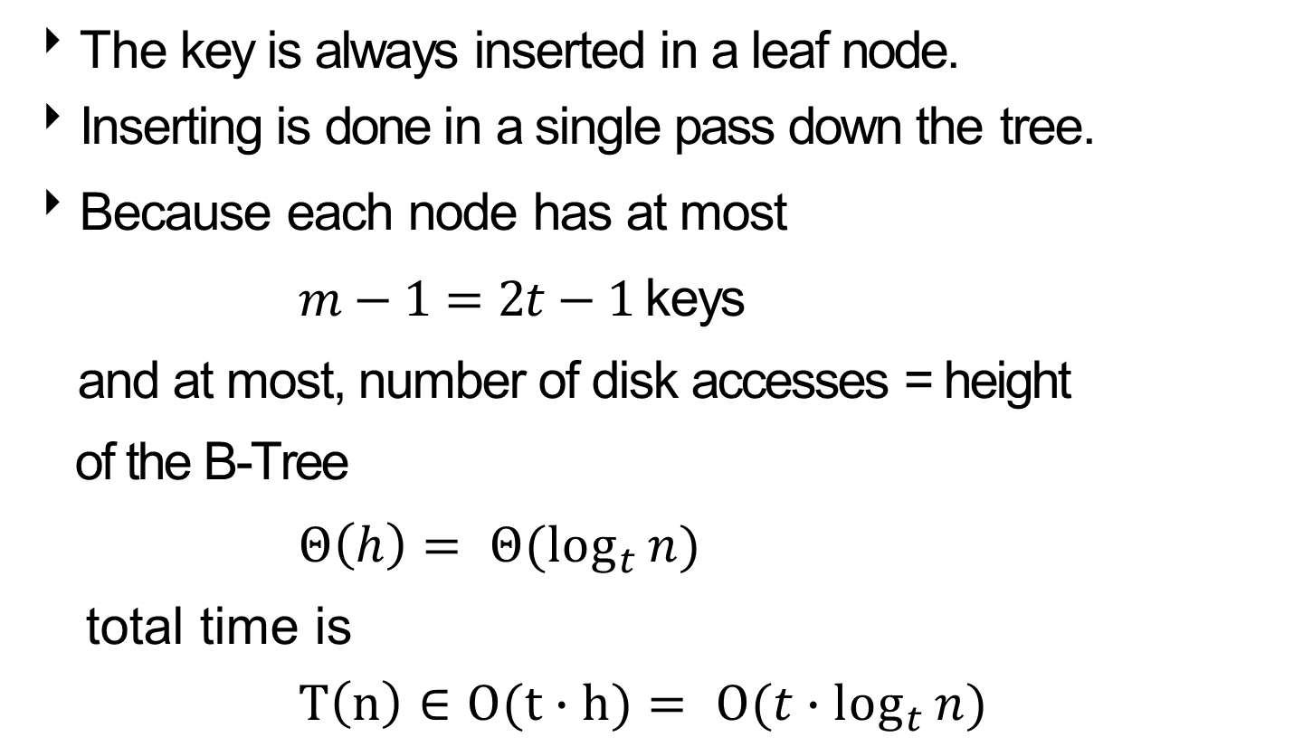
Analysis of B-Tree Insertion
The key is always inserted in a leaf node.
Inserting is done in a single pass down the tree.
Because each node has at most
$m−1=2t−1$keys
and at most, number of disk accesses = height
of the B-Tree
$Θ\left(h\right)= Θ(\log_{t}{n)}$
total time is
$T\left(n\right)∈O(t∙h)= O(t∙\log_{t}{n)}$

Slide 51
Constructing a B-Tree
Start with an empty B-Tree.
Insert <key, data> pairs as they arrive.
If constructing a B-Tree of order m:
All nodes, except the root, can only have m children / m-1 keys.
Internal nodes and leaves must have at least t children / t-1 keys.

Slide 52
Constructing a B-Tree
For example, assume creating B-Tree of order 4
m = 4
t = ⎡m/2⎤ = 2
And keys arrive in the following order:
1 12 8 2 25 5 14 28 17 7 52 16 48 68 3 26 29 53 55 45
The first three items go into the root:
1 | 8 | 12

Slide 53
Constructing a B-Tree
Add 2.
But the root has too many keys.
1 | 2 | 8 | 12
Split root and promote middle key 2 to new root.
2
1
8 | 12

Slide 54
Constructing a B-Tree
Add 25 to the leaf node:
2
1
8 | 12 | 25
Add 5.
But the leaf has too many keys.
2
1
5 | 8 | 12 | 25

Slide 55
Constructing a B-Tree
Split leaf and promote middle key 8 to root.
2 | 8
1
5
12 | 25
Add 14, 28.
But the leaf has too many keys.
2 | 8
1
5
12 | 14 | 25 | 28

Slide 56
Constructing a B-Tree
Split leaf and promote middle key 14 to root.
2 | 8 | 14
1
5
12
25 | 28
Add 17, 7, 52.
But the leaf has too many keys.
2 | 8 | 14
1
5 | 7
12
17 | 25 | 28 | 52

Slide 57
Constructing a B-Tree
Split leaf and promote middle key 25 to root.
2 | 8 | 14 | 25
But the root has too many keys.
1
5 | 7
12
17
28 | 52
Split root and promote middle key 8 to new root.
8
2
14 | 25
1
5 | 7
12
17
28 | 52

Slide 58
Constructing a B-Tree
Add 16, 48, 68.
8
But the leaf has too many keys.
2
14 | 25
1
5 | 7
12
16 | 17
28 | 48 | 52 | 68
Split leaf and promote middle key 48 to its parent.
8
2
14 | 25 | 48
1
5 | 7
12
16 | 17
28
52 | 68

Slide 59
Constructing a B-Tree
Add 3, 26, 29, 53, 55.
8
2
14 | 25 | 48
1
3 | 5 | 7
12
16 | 17
26 | 28 | 29
52 | 53 | 55 | 68
Split leaf and promote middle key 53 to its parent.
8
But internal node has too many keys.
2
14 | 25 | 48 | 53
1
3 | 5 | 7
12
16 | 17
26 | 28 | 29
52
55 | 68

Slide 60
Constructing a B-Tree
Split node and promote middle key 25 to the root.
8 | 25
2
14
48 | 53
1
3 | 5 | 7
12
16 | 17
26 | 28 | 29
52
55 | 68
Add 45.
8 | 25
2
14
48 | 53
But leaf has too many keys.
1
3 | 5 | 7
12
16 | 17
26 | 28 | 29 | 45
52
55 | 68

Slide 61
Constructing a B-Tree
Split leaf and promote middle key 28 to its parent.
8 | 25
2
14
28 | 48 | 53
1
3 | 5 | 7
12
16 | 17
26
29 | 45
52
55 | 68

Slide 62
Constructing a B-Tree
8 | 25
2
14
28 | 48 | 53
1
3 | 5 | 7
12
16 | 17
26
29 | 45
52
55 | 68

Slide 63
Example: Constructing B-Tree
Construct a 4-way B-tree the following keys:
3 7 9 23 45 1 5 14 25 24 13 11 8 19 4 31 35 56

Slide 64
Example: Constructing B-Tree
Construct a 4-way B-tree the following keys:
3 7 9 23 45 1 5 14 25 24 13 11 8 19 4 31 35 56
The resulting B-tree:
9
3 | 7
14 | 24 | 31
1
4 | 5
8
11 | 13
19 | 23
25
35 | 45 | 56

Slide 65
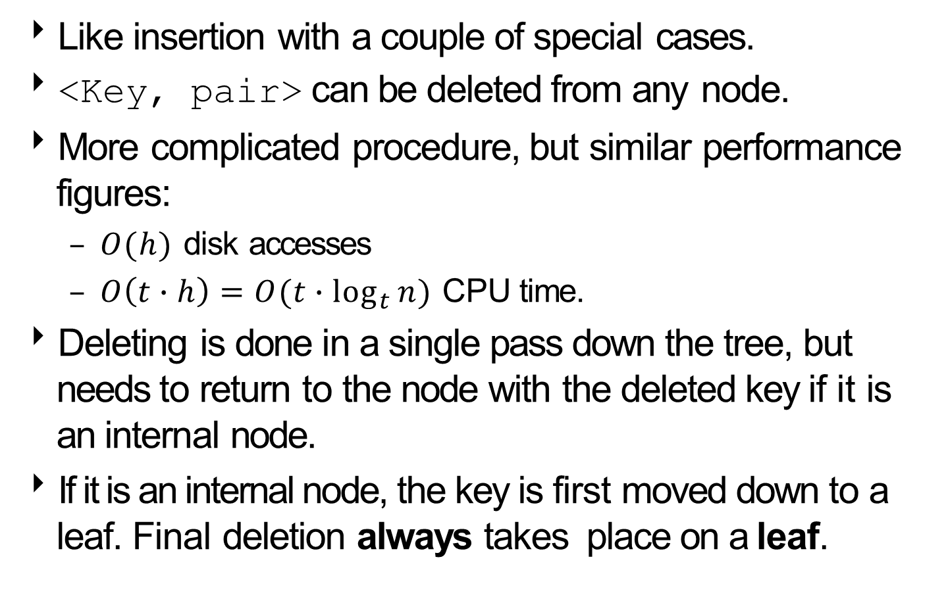
B-Tree Deletion
Like insertion with a couple of special cases.
<Key, pair> can be deleted from any node.
More complicated procedure, but similar performance figures:
$O(h)$ disk accesses
$O\left(t∙h\right)=O(t∙\log_{t}{n)}$ CPU time.
Deleting is done in a single pass down the tree, but needs to return to the node with the deleted key if it is an internal node.
If it is an internal node, the key is first moved down to a leaf. Final deletion always takes place on a leaf.

Slide 66
Steps of B-Tree Deletion
Given k, the key of the object to be deleted, and x, the root of a subtree containing k, our approach to B-Tree deletion recursively searches subtrees of x until find k.
The approach requires x to contain at least t keys, one more than the usual B-Tree conditions.
This requirement may force a rearrangement of the subtree before the search can continue.
Deletion of a key can be down in one downward pass with any backtracking.

Slide 67
B-Tree Deletion: Step 1
Recursively find the key k.
If the key k is not present in the internal node x, find the child of x, x.c_{j} that is the root of a subtree that contains the key k.
If x.c_{j} has at least t keys, continue recursive search in the subtree rooted by x.c_{j}.
If x.c_{j} has only t-1 keys, execute one of the following steps to ensure we always descend to a child node with at least t keys before continuing recursive search in the subtree rooted by x.c_{j}:

Slide 68
B-Tree Deletion: Step 1
If either x.c_{i} , x.c_{j}’s left sibling, or x.c_{k} , x.c_{j}’s right sibling, has more than the minimum number of keys:
let the key k_{p} be the key in x that determines the range between x.c_{i} and x.c_{j}, or x.c_{j} and x.c_{k}
replace k_{p} with the maximum key of x.c_{i} or the minimum key of x.c_{k}.
then insert k_{p} into x.c_{j}.
If both x.c_{i} and x.c_{k} have t-1 keys:
combine x.c_{j} with either x.c_{i} or x.c_{k} and k_{p}.
if x is the root node and loses all of its keys
delete x.
x’s only child x.c₁ becomes the new root.

Slide 69
B-Tree Deletion: Step 2
When find the node x that contains the key k, there are two possibilities:
x is a leaf node, or
x is an internal node
If x is a leaf, then just delete the key k from x.
If x is an internal node
x’s predecessor y or its successor z will be a leaf.
A node’s predecessor is the rightmost node in its left sibling’s subtree.
A node’s successor is the leftmost node in its right sibling’s subtree.

Slide 70
B-Tree Deletion: Step 2
2b. Internal nodes (cont’d).
If either y or z has more than the minimum number (t-1) keys,
replace k’s position in x with the maximum key of y or the minimum key of z.
If both y and z have t-1 keys
remove the key k from x
add z’s keys to y, creating a single node
remove the pointer to z in x
if x is the root node and loses all of its keys
delete x.
x’s only child y becomes the new root.

Slide 71
Simple Leaf Deletion
Initial 6-way B-Tree:
16
t = 3
3 | 7 | 13
20 | 23
1 | 2
4 | 5 | 6
10 | 11 | 12
14 | 15
17 | 18 | 19
21 | 22
24 | 26
delete 6:
16
3 | 7 | 13
20 | 23
1 | 2
4 | 5
10 | 11 | 12
14 | 15
17 | 18 | 19
21 | 22
24 | 26
Other nodes in search contain > t-1 = 2 keys.
Delete the key from the leaf.
t−1 = 2 keys remain.

Slide 72
Internal Node Deletion I
Initial tree:
16
3 | 7 | 13
20 | 23
1 | 2
4 | 5
10 | 11 | 12
14 | 15
17 | 18 | 19
21 | 22
24 | 26
delete 13:
16
3 | 7 | 12
20 | 23
1 | 2
4 | 5
10 | 11
14 | 15
17 | 18 | 19
21 | 22
24 | 26
The maximum key of the predecessor of 13, moves up and takes 13’s position.
The predecessor has at least t-1 = 2 keys.

Slide 73
Internal Node Deletion II
Initial tree:
16
3 | 7 | 12
20 | 23
1 | 2
4 | 5
10 | 11
14 | 15
17 | 18 | 19
21 | 22
24 | 26
delete 7:
16
3 | 12
20 | 23
1 | 2
4 | 5 | 10 | 11
14 | 15
17 | 18 | 19
21 | 22
24 | 26
Both predecessor and successor have t−1 = 2 keys.
Combine 7 with the children nodes to form one leaf.
Remove 7 from that leaf.

Slide 74
Complex Leaf Deletion I
Initial tree:
16
3 | 12
20 | 23
1 | 2
4 | 5 | 10 | 11
14 | 15
17 | 18 | 19
21 | 22
24 | 26
delete 4:
16
3 | 12
20 | 23
1 | 2
4 | 5 | 10 | 11
14 | 15
17 | 18 | 19
21 | 22
24 | 26
Recursion cannot descend to (3, 12) node because it has t−1 = 2 keys.
The sibling of (3, 12) has also t−1 = 2 keys.
Have to merge root with its two children, before 4 can be deleted from the leaf.

Slide 75
Complex Leaf Deletion I
delete 4:
3 | 12 | 16 | 20 | 23
1 | 2
4 | 5 | 10 | 11
14 | 15
17 | 18 | 19
21 | 22
24 | 26
delete 4:
3 | 12 | 16 | 20 | 23
1 | 2
5 | 10 | 11
14 | 15
17 | 18 | 19
21 | 22
24 | 26
Remove root with no keys, and replace with its only child.
Delete 4 from the leaf.

Slide 76
Complex Leaf Deletion II
Initial tree:
3 | 12 | 16 | 20 | 23
1 | 2
5 | 10 | 11
14 | 15
17 | 18 | 19
21 | 22
24 | 26
delete 2:
5 | 12 | 16 | 20 | 23
1 | 3
10 | 11
14 | 15
17 | 18 | 19
21 | 22
24 | 26
Recursion cannot descend to (1, 2) node because it has t−1 = 2 keys.
But its sibling (5, 10, 11) has t = 3 keys.
Move 5 up to root and 3 down to (1, 2)
Finally, remove 2

Slide 77
Example: B-Tree
Given 4-way B-tree created by these data (last exercise):
3 7 9 23 45 1 5 14 25 24 13 11 8 19 4 31 35 56
9
3 | 7
14 | 24 | 31
1
4 | 5
8
11 | 13
19 | 23
25
35 | 45 | 56

Slide 78
Example: B-Tree
Add these additional keys: 2 6 12

Slide 79
Example: B-Tree
Add these additional keys: 2 6 12
9
3 | 7
14 | 24 | 31
1 | 2
4 | 5 | 6
8
11 | 12 | 13
19 | 23
25
35 | 45 | 56

Slide 80
Example: B-Tree
Delete these keys: 4 5 7 3 14

Slide 81
Example: B-Tree
Delete these keys: 4 5 7 3 14
13
2 | 9
24 | 31
1
6 | 8
11 | 12
19 | 23
25
35 | 45 | 56

Slide 82
Example: B-Tree
Delete these keys: 4 5 7 3 14
OR
13
6 | 9
24 | 31
1 | 2
8
11 | 12
19 | 23
25
35 | 45 | 56

Slide 83
Deletion Algorithm I
function B-Tree-Delete(x, k)
// input: x, a B-Tree node that is root of subtree
// k, key of object deleting from tree
if x.contains(k) then
Remove-Key(k, x)
if not x.leaf // internal node
y ← Predecessor(x)
z ← Successor(x)
if y.n > t − 1 then
temp-key ← Max-Key(y)
Move-Key(temp-key, y, x)
else if z.n > t − 1 then
temp-key ← Min-Key(z)
Move-Key(temp-key, z, x)
else Merge-Nodes(y, z)
Remove-Child(x, z)
if Is-Root(x) and x.n = 0 then
Make-Root(y)

Slide 84
Deletion Algorithm II
else // key k not found
c ← Find-Child(x, k)
if c.n = t − 1 then
b ← Left-Sibling(c)
d ← Right-Sibling(c)
if b.n > t − 1 then
parent-key ← Child-Key(x, b, c)
Move-Key(parent-key, x, c)
temp-key ← Max-Key(b)
Move-Key(temp-key, b, x)
else if d.n > t − 1 then
parent-key ← Child-Key(x, c, d)
Move-Key(parent-key, x, c)
temp-key ← Min-Key(d)
Move-Key(temp-key, d, x)
else Merge-Nodes(c, d)
Remove-Child(x, d)
if Is-Root(x) and x.n = 0 then
Make-Root(c)
B-Tree-Delete(k, c)

Slide 85
Implementing B-Trees
The root of the B-Tree is stored in main memory.
All other nodes are stored on the disk.
The size of a node is equal to the size of the disk page.
To access nodes other than the root, we perform a disk-read operation.
At most we have O(h) disk-read operations.

Slide 86
Why B-Trees?
When searching tables on disk:
The cost of each disc transfer is high.
But doesn't depend much on the amount of data transferred, especially if consecutive items are transferred.
If we use a B-Tree of order 101:
Transfer each node in one disk read operation.
With height 3 can hold 101⁴ – 1 items (approximately 100 million).
Any item can be accessed with 3 disk reads (assuming we hold the root in memory).

Slide 88
Comparing Trees
Binary trees
Can become unbalanced and lose their good time complexity (big O)
AVL trees are strict binary trees that overcome the balance problem
Heaps remain balanced but only prioritise (not order) the keys

Slide 89
Comparing Trees
Multi-way trees
B-Trees can be m-way, they can have any (odd) number of children
One B-Tree, the 2-3 (or 3-way) B-Tree, approximates a permanently balanced binary tree, exchanging the AVL tree’s balancing operations for insertion and (more complex) deletion operations

